Slide 1



Mask please Game
Enjoy MaskPlease!
STArt

Slide 2





TABLE OF CONTENTS
Goals
STRATEGY
Goals
strategy
idea
idea
REPUSCORE
Demo
development
REPUSCORE
development
DEMO

Slide 3
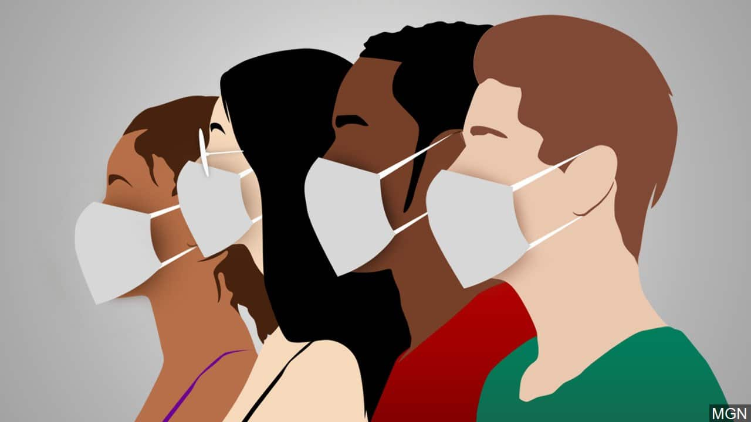
Goals
Goals
STRATEGY
idea
Rispetto norme anti-covid
Coscienza sociale
Mascherina sempre con sé
REPUSCORE
development
DEMO

Slide 4
Goals
Goals
STRATEGY
idea
Rispetto norme anti-covid
Coscienza sociale
Mascherina sempre con sé
REPUSCORE
development
… e se creassimo un’ App?
DEMO

Slide 5
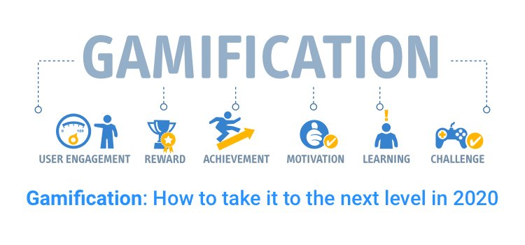
STRATEGY
Goals
gamification
STRATEGY
idea
REPUSCORE
development
DEMO

Slide 6

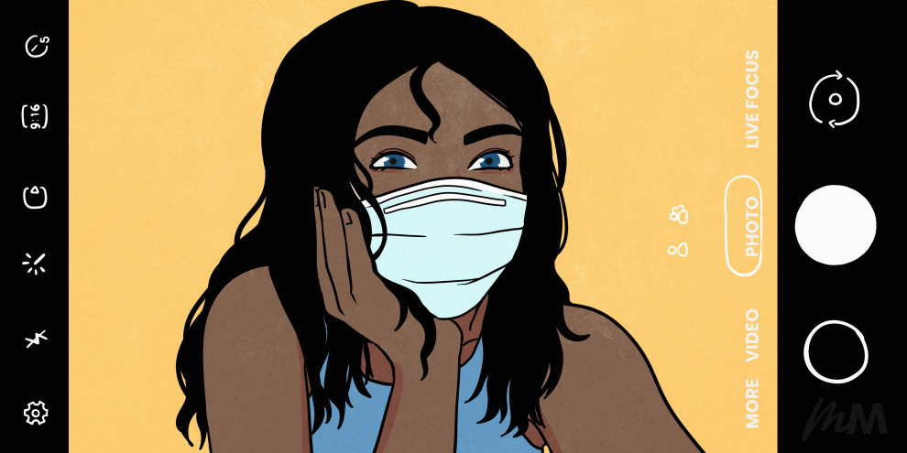

idea
Goals
STRATEGY
idea
GPS
NOTIFICATION
PHOTO
REPUSCORE
Tracking spostamento fuori casa
Notifica uso
mascherina
Riconoscimento mascherina al volto
development
DEMO

Slide 7
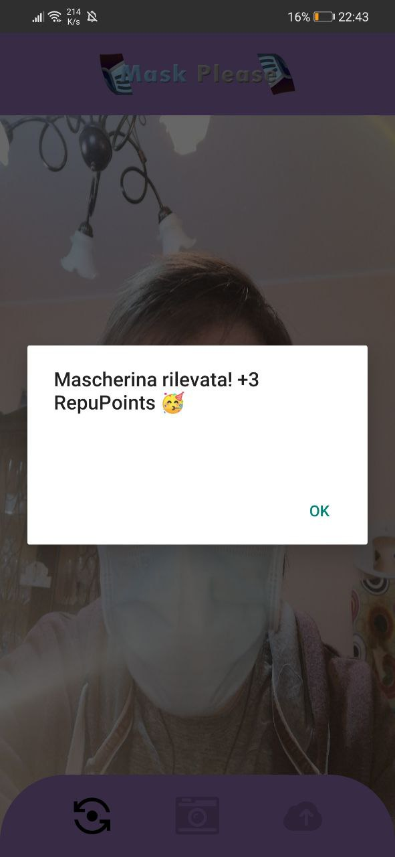
RepuSCore
-1
Goals
-1
STRATEGY
idea
+3
-10
REPUSCORE
development
+3
-10
DEMO

Slide 8


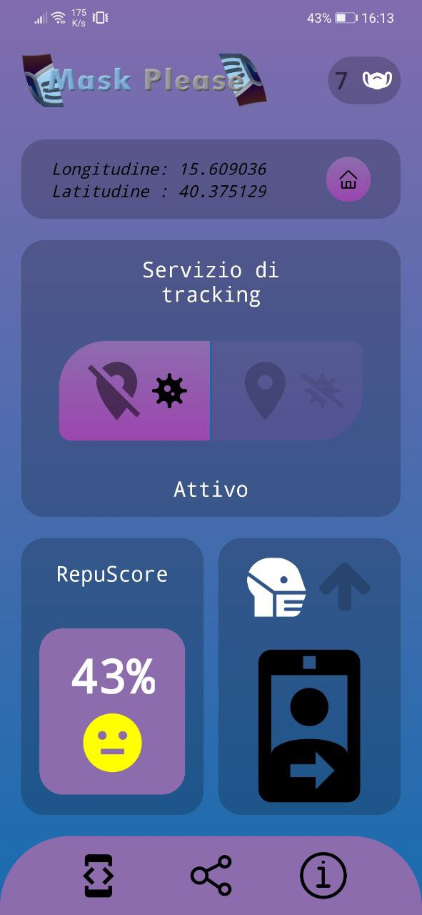
RepuShare
Goals
STRATEGY
"Hey, questo è il mio RepuScore: 43
Unisciti alla community di MaskPlease 😷"
idea
REPUSCORE
development
DEMO

Slide 9


ANDroid App
React Native App
Mask Counter
Servizio di Tracking
Sezione Camera
RepuScore
Notifiche push
Condivisione RepuScore
Tutorial
Sezione FAQ
Goals
STRATEGY
idea
REPUSCORE
development
DEMO

Slide 10




Microsoft Azure
Goals
Logica Serverless (NodeJS)
Microfatturazione
Tempi ridotti
Efficienza microservizi
STRATEGY
idea
REPUSCORE
development
DEMO

Slide 11
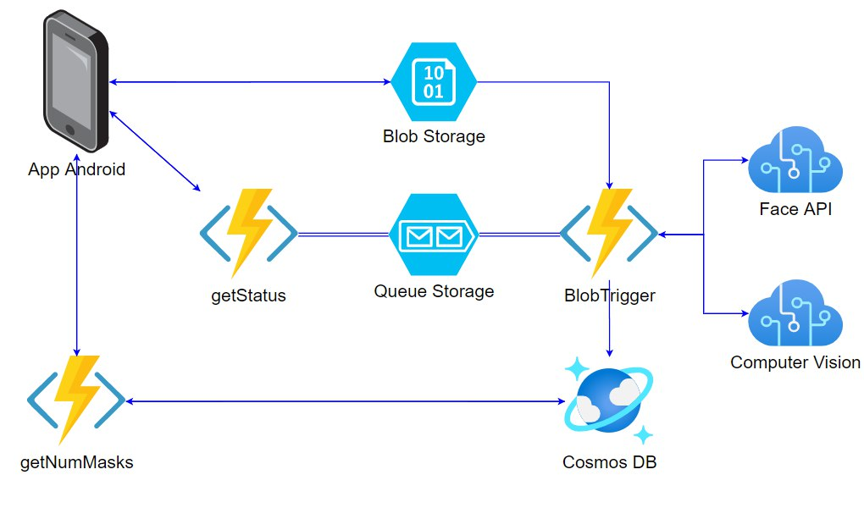
Architecture
Goals
STRATEGY
Azure Functions
Blob Storage
Cognitive Services
Cosmos DB
Queue Storage
idea
REPUSCORE
development
DEMO

Slide 12
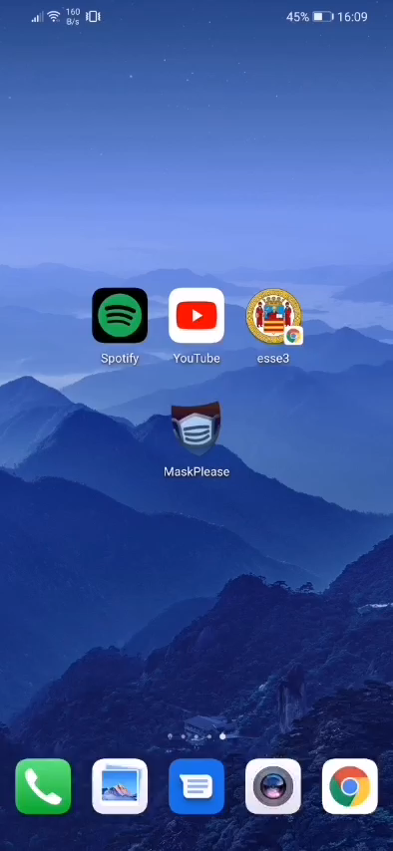


DEMO
Goals
Ricezione notifica
Assegnazione RepuPoint
STRATEGY
1
2
3
4
idea
Attivazione servizio di tracking
+3
Acquisizione Foto
REPUSCORE
development
DEMO

Slide 13
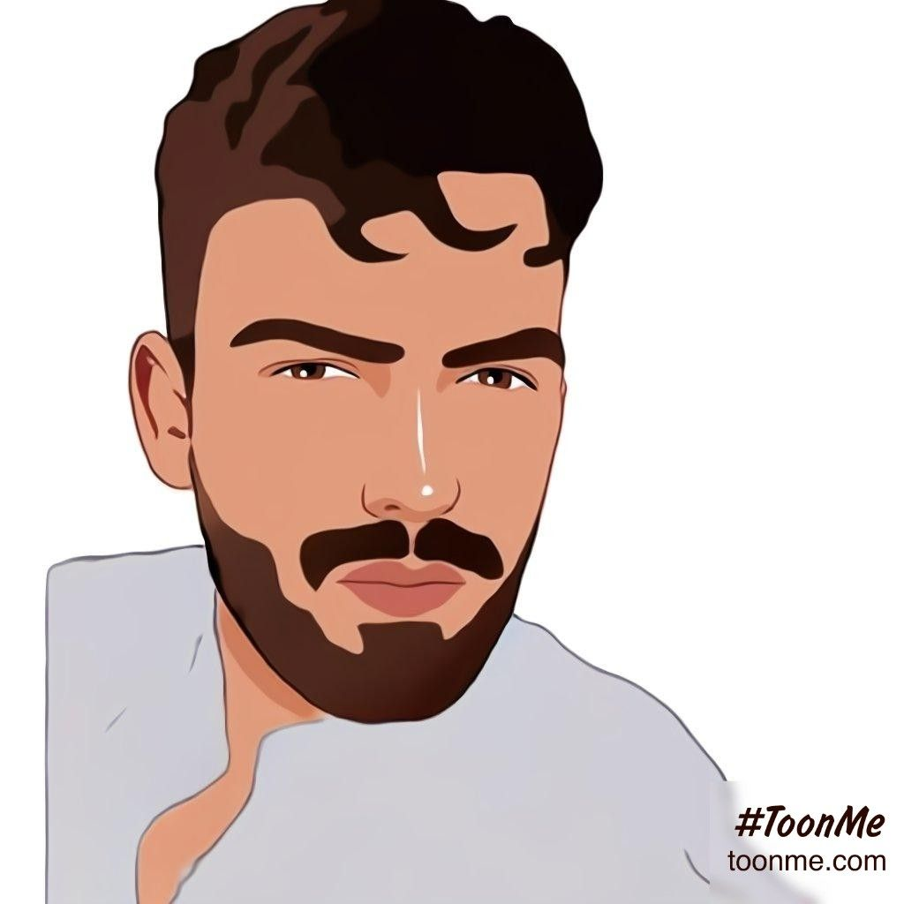

OUR TEAM
Goals
@fab.priore
STRATEGY
idea
REPUSCORE
Fabiano Priore
development
@_fernet_
DEMO
Pierluigi Liguori

Slide 14

GAME OVER
THanks!
Repository Git:
Back-end: https://github.com/Fab001/MaskPleaseBackend
Front-end: https://github.com/Fernet97/MaskPlease

